Slide 1
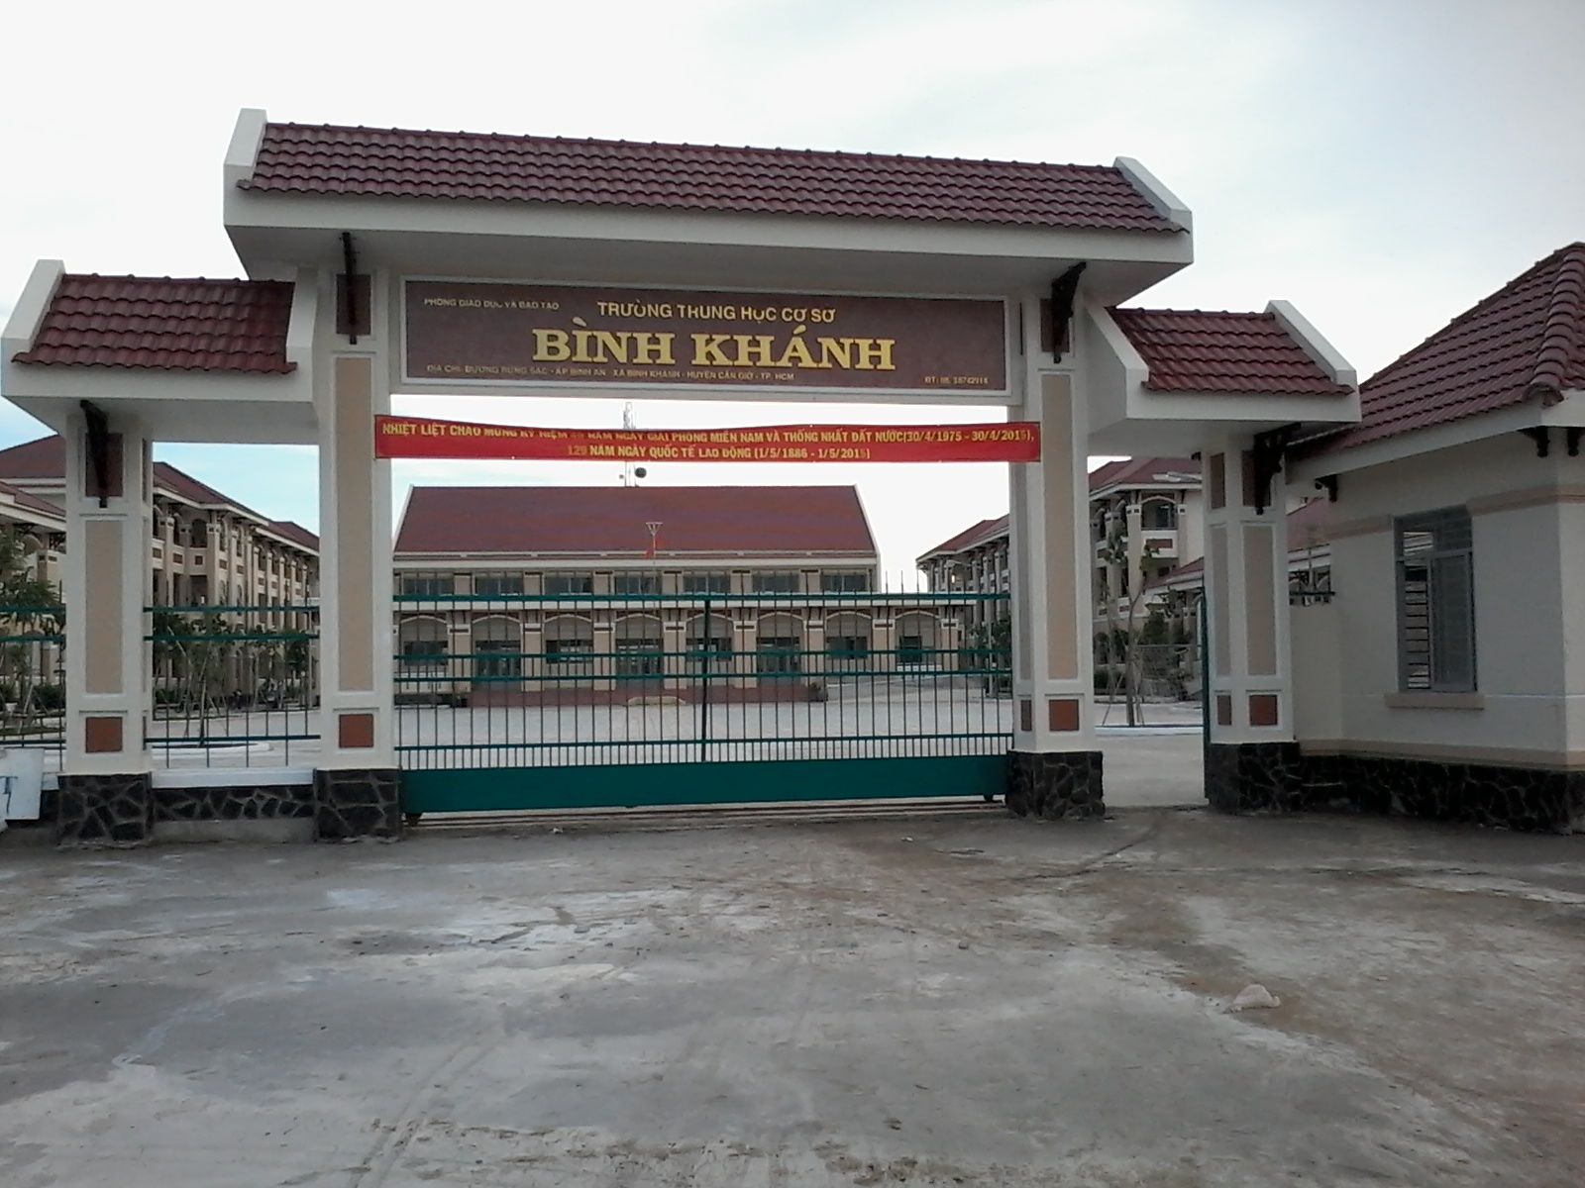



BINH KHANH SECONDARY SCHOOL
FRIENDS PLUS 6

Slide 2

UNIT 8: GOING AWAY
LESSON 6: SPEAKING

Slide 3

GUESSING GAME!

Slide 4
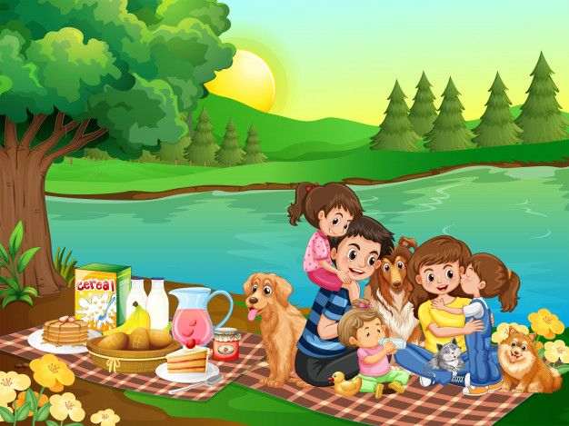

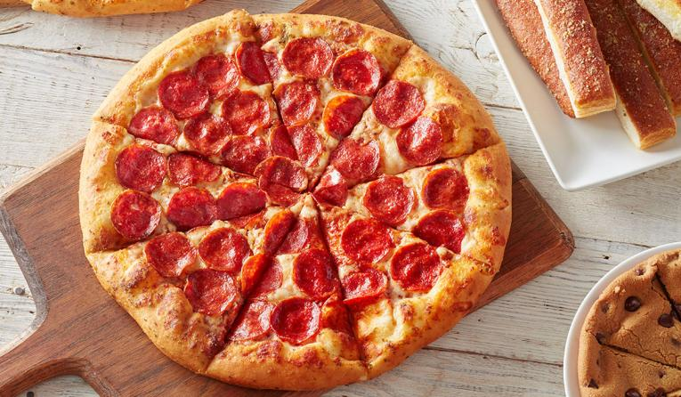

picnic
beach
pizza
sandwich

Slide 5

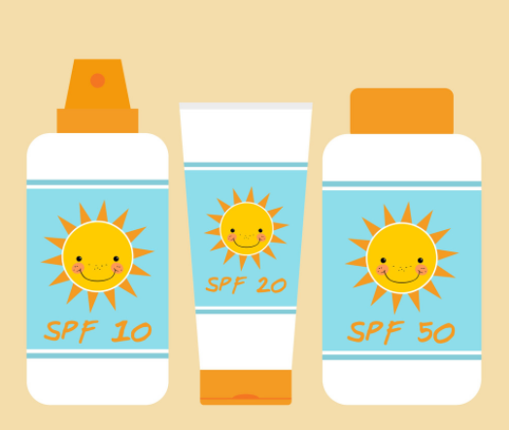


Sun cream
chicken
drinks
house

Slide 6
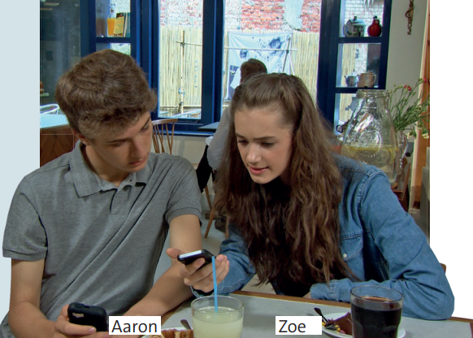
Look at the photo of Zoe and Aaron.
What do you think they are talking about?

Slide 7
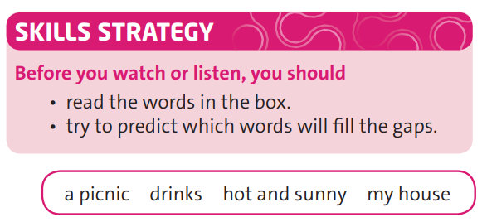
EXERCISE 1: Read the Skills Strategy. Then watch or listen and complete the dialogue with the words in the box. Who are they going to invite?

Slide 8
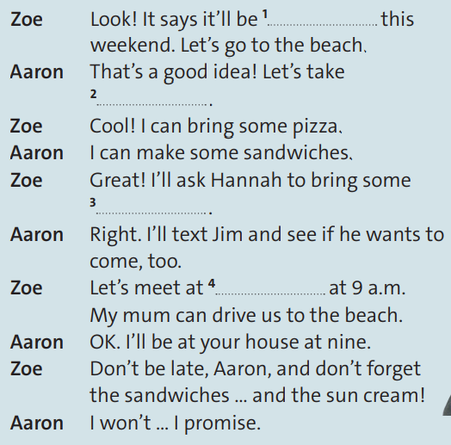
a picnic
drinks
hot and sunny
my house

Slide 9
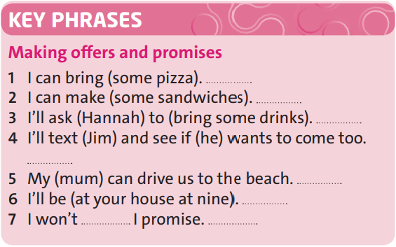
EXERCISE 2: Watch or listen again. Which key phrases are for making offers and which are for making promises? Write O (offers) or P (promises).
Then practise the dialogue with a partner.
O
O
P
P
O
P
P

Slide 10
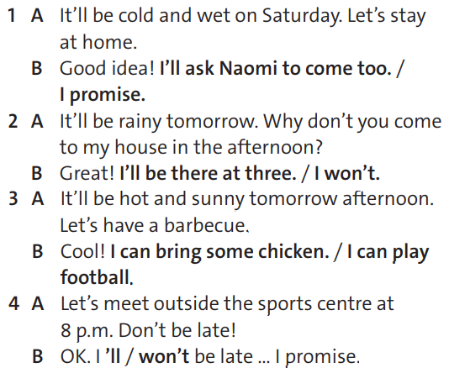
EXERCISE 3: Choose the correct responses in the mini-dialogues. Listen and check.

Slide 11

* Optional activity: Work in pairs.
Optional activity: Speaking
Ask students to close their books. Read out the first lines of the mini-dialogues from exercise 3 in a random order. See if students can remember the correct responses.

Slide 12

EXERCISE 4: Work in pairs. Look at the situations and choose A or B. Prepare and practise a new dialogue. Use the Key Phrases and the dialogue in exercise 1 to help you.
Situation A:
It will be cold and rainy this weekend. You want to watch a DVD with some friends.
Situation B:
It will be hot and sunny this weekend. You want to go to the park.
Situation A
Situation B

Slide 13
Eg:
+ Student 1: Look! It'll be cool and sunny this weekend. How about going to the beach?
+ Student 2: That's great. Let's take a picnic
+ Student 1:Well, I can bring some chicken and pizzas
+ Student 2: Uhmmm, so I make some sandwiches
.....
Situation A
Situation B

Slide 14
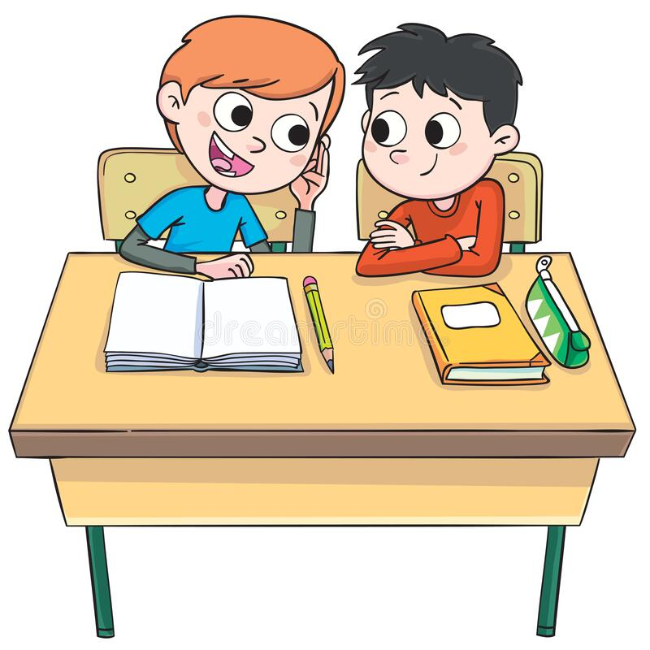
EXERCISE 5: Use it – Work in pairs.
Optional activity: Speaking
Brainstorm some more things that students might want to do if it is going to be hot and sunny or cold and rainy at the weekend, e.g. play tennis, go to the swimming pool, go to the beach, go to the cinema. Put students into new pairs to practise a new dialogue. Encourage students this time not to prepare their dialogue in advance, but to try to speak naturally, just using the key phrases to help them. Ask students to report back on how easy or difficult they found this.

Slide 15


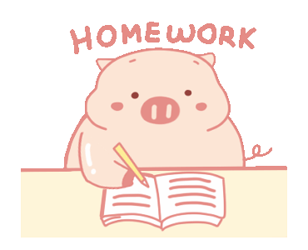
- Learn by heart all structures.
- Do exercises page 109
- Write some sentences using phrase keys.
- Prepare for the next lesson: Writing

